Slide 1
A Project On
Website
EasyWriteup
Department of Computer Science & Information Technology
GURU GHASIDAS VISHWAVIDYALAYA, BILASPUR (C.G.)
SESSION 2017
Submitted to:
Mr. Mustafa Ansari
Asst. Prof.
Department of CSIT
Submitted by
Devesh Sahu
Digvijay
MCA IV Sem

Slide 2
Objective
To provide platform where you can showcase your writing skill .
To enhance the writing skills by consulting with experienced writers.
To provide Writeups a worldwide reach.
To provide information about what the Easywriteup.com is and what the activities going around.
To provide a facility to the user to post an writeup from anywhere or anytime.

Slide 3
Introduction
This is a public blog driven by professional Admin. This website is developed to provide you a platform where you can showcase your writing skills. This is a easy way of sharing poetry, articles and blogs worldwide on internet by using this website easywriteup.com . Write-ups posted on Easywriteup website can be like and shared by any user, which gives you worldwide reach to write-ups, posted by any user on the website. It takes complete information about writers who posted their Write-ups on the website.

Slide 4
Software & Hardware Requirement
Software Requirement:
Windows 10 O/S, Google Chrome/Internet Explorer,
XAMPP Server, My SQL Server, PHP 7.1.4
Apache Tomcat 8.5.13 etc.
Hardware Requirement:
1.8 GHz processor,
1GB RAM,
20GB Hard disk etc.

Slide 5
Flowchart
Start
Demo Page
Login
If existing user
?
Home
Yes
Login
No
Register

Slide 6
Data Flow Diagram
Admin:
Database
AUTHENTICATE ADMIN
ADMIN LOGIN
LOG IN
DASHBOARD
POST APPROVAL
WRITERS

Slide 7
Modules
HOME
BLOG
1. THOUGHTS
2. POETRY
3. ARTICLES
4. NOSTALGIA
5. UNCATEGORISED
MEMBER LOG_IN
TEAM
ABOUT
CONTACT

Slide 8
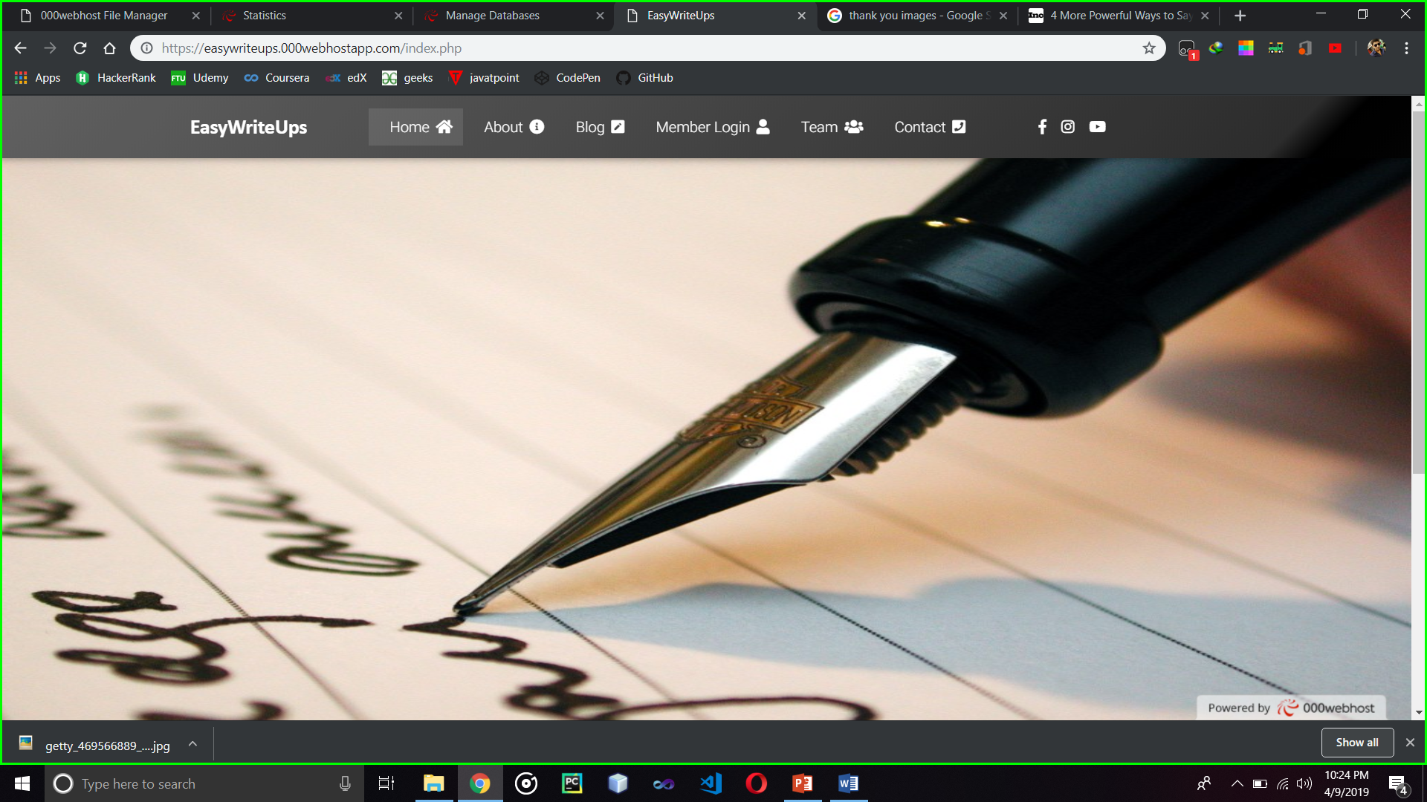
MASTER PAGE

Slide 9
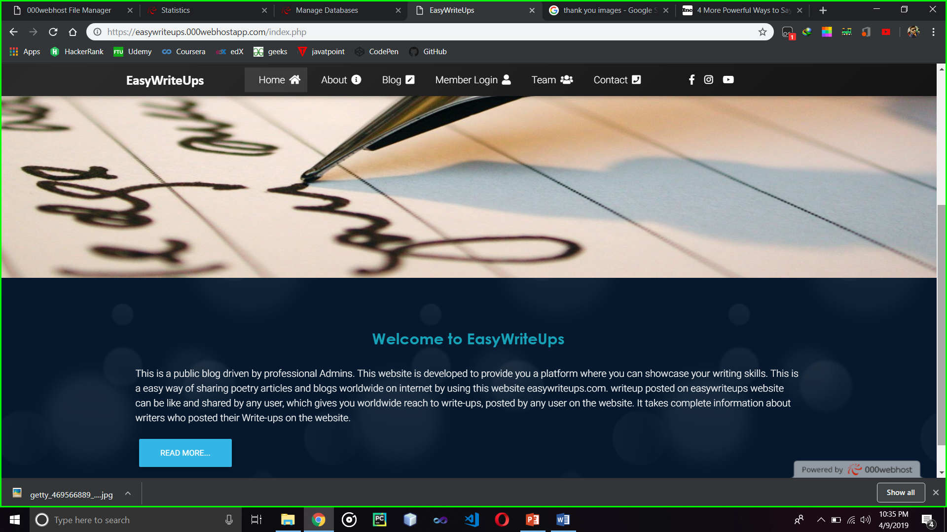
HOME PAGE

Slide 10
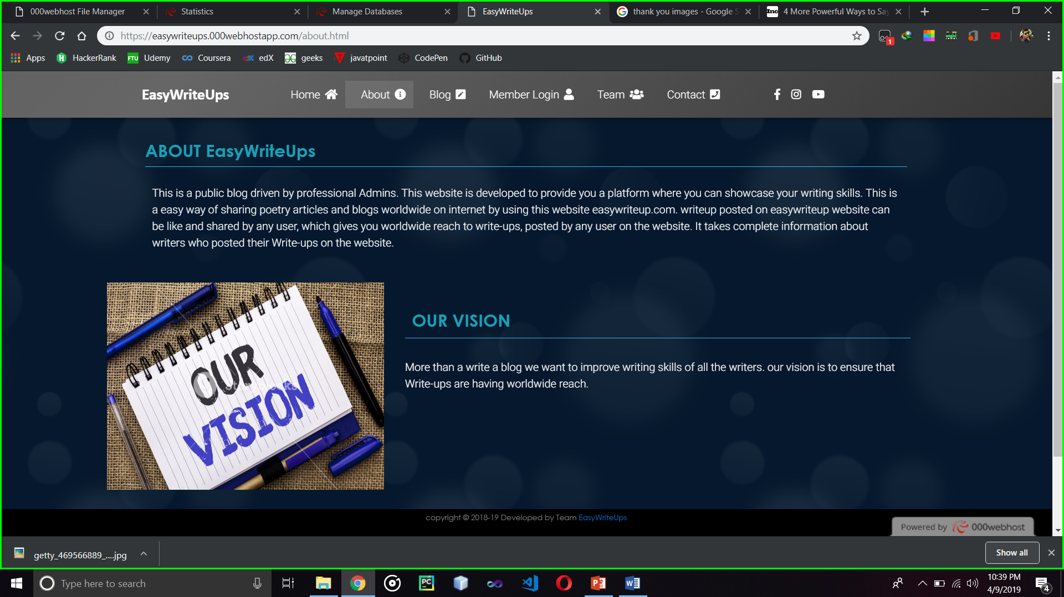
ABOUT PAGE

Slide 11
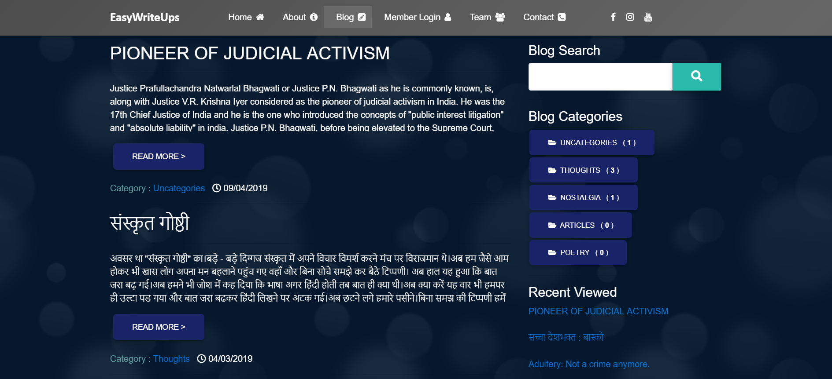
BLOG PAGE

Slide 12
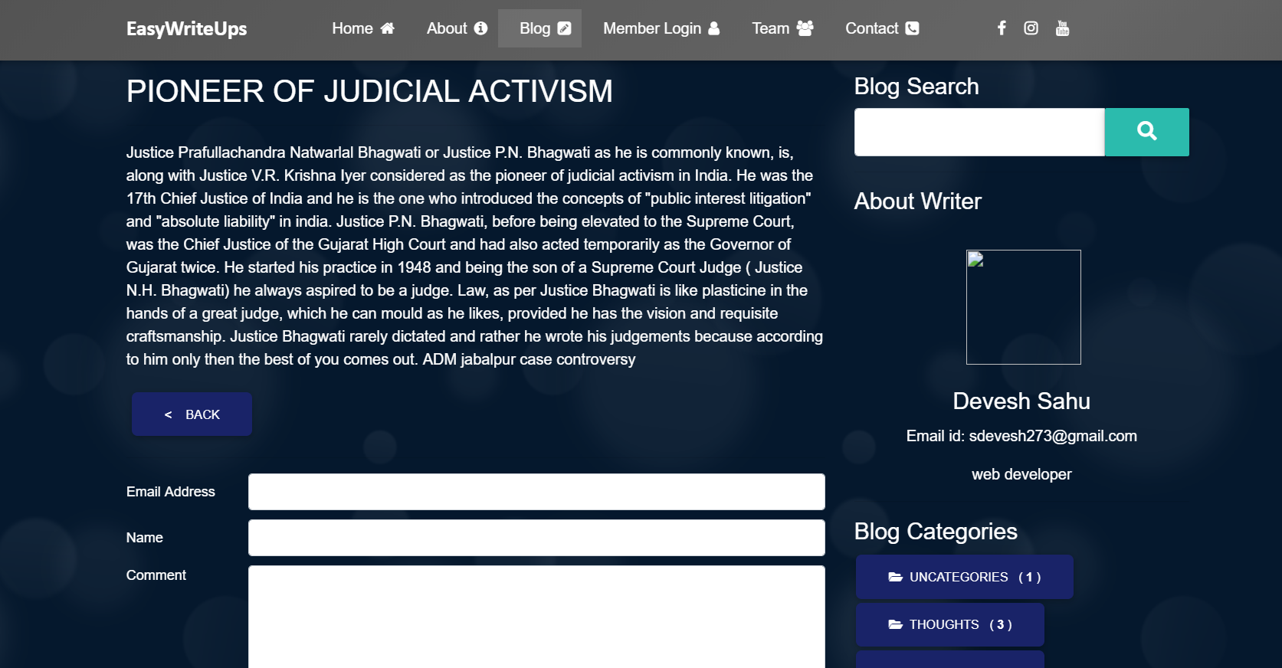
By clicking Read More of any article you go to the below page:

Slide 13
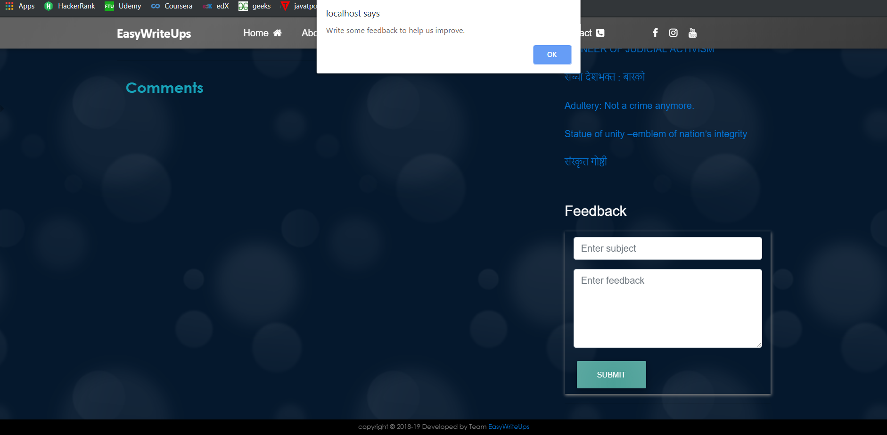
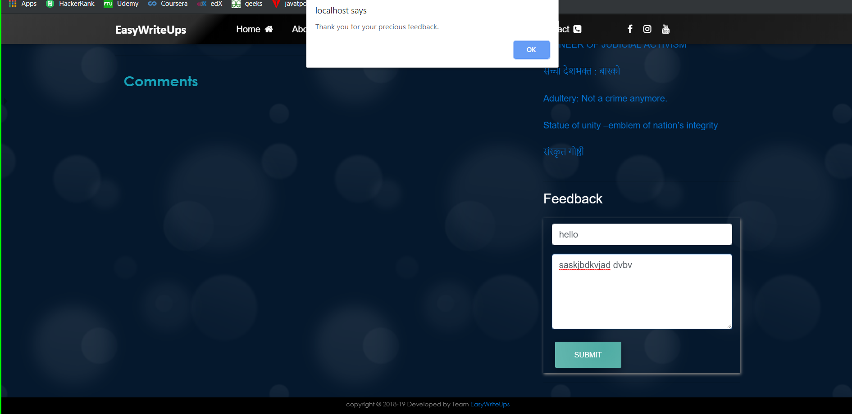
Feedback Form

Slide 14
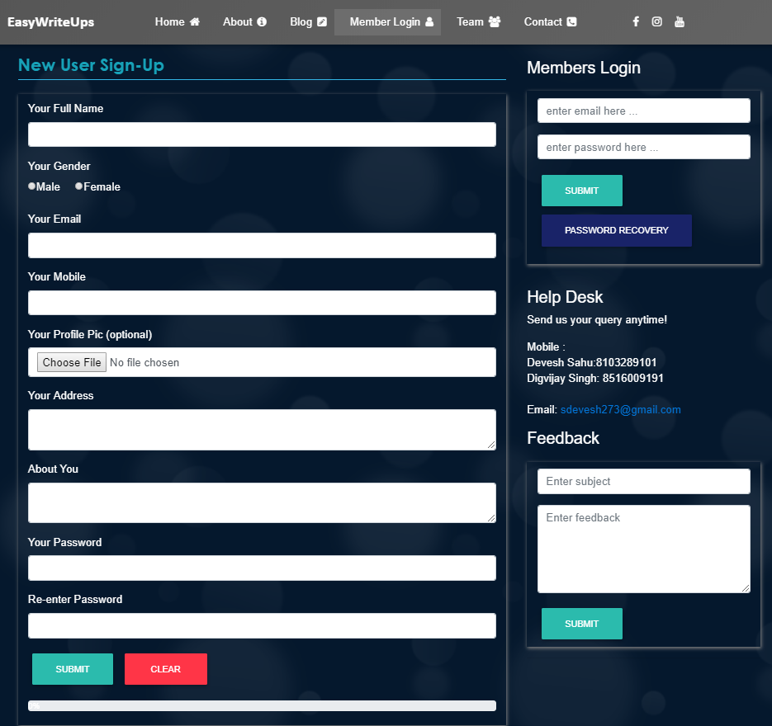
Login Register Page

Slide 15
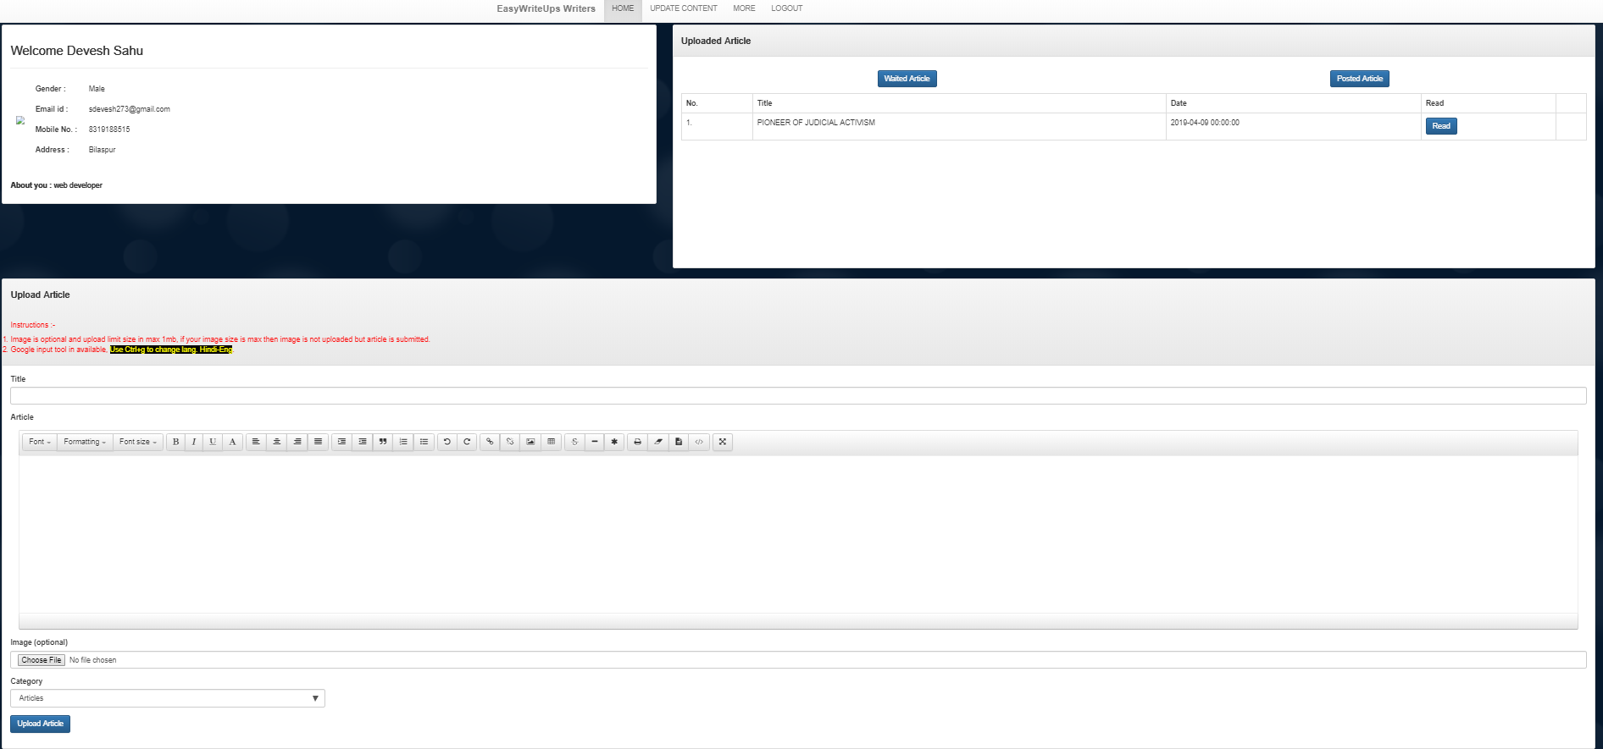
Writer Home

Slide 16
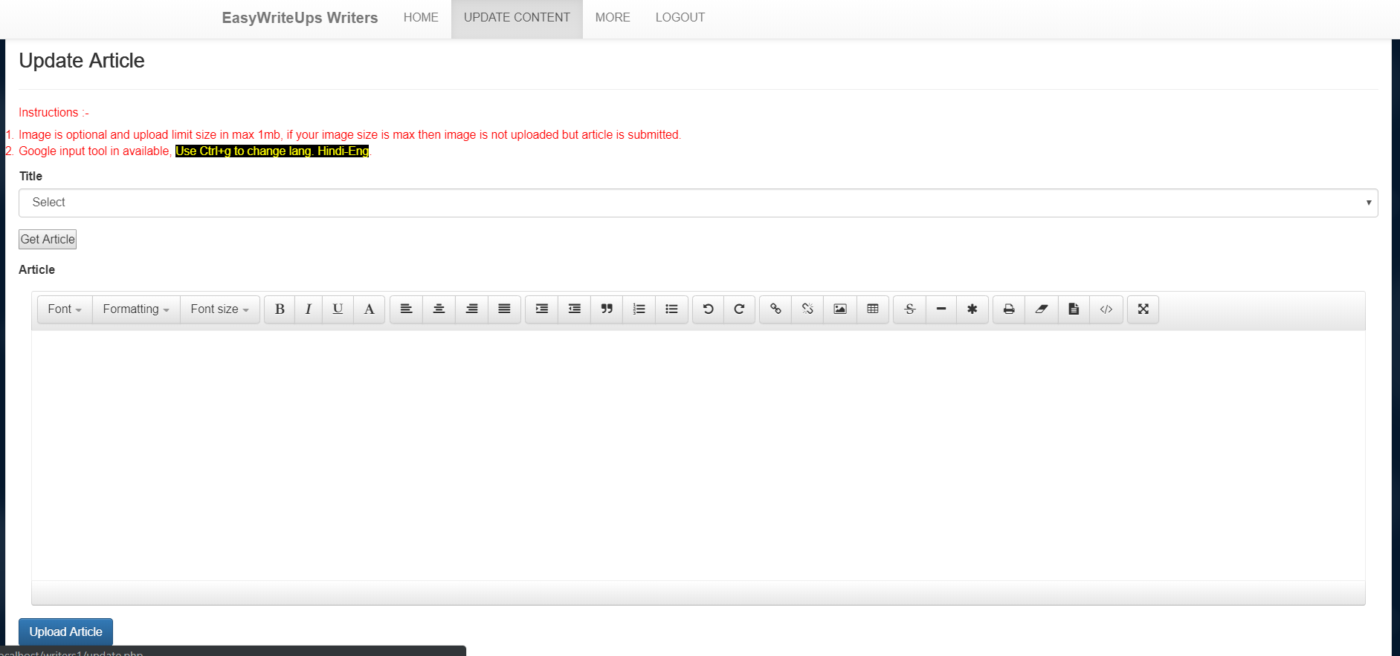
Update Article Page

Slide 17
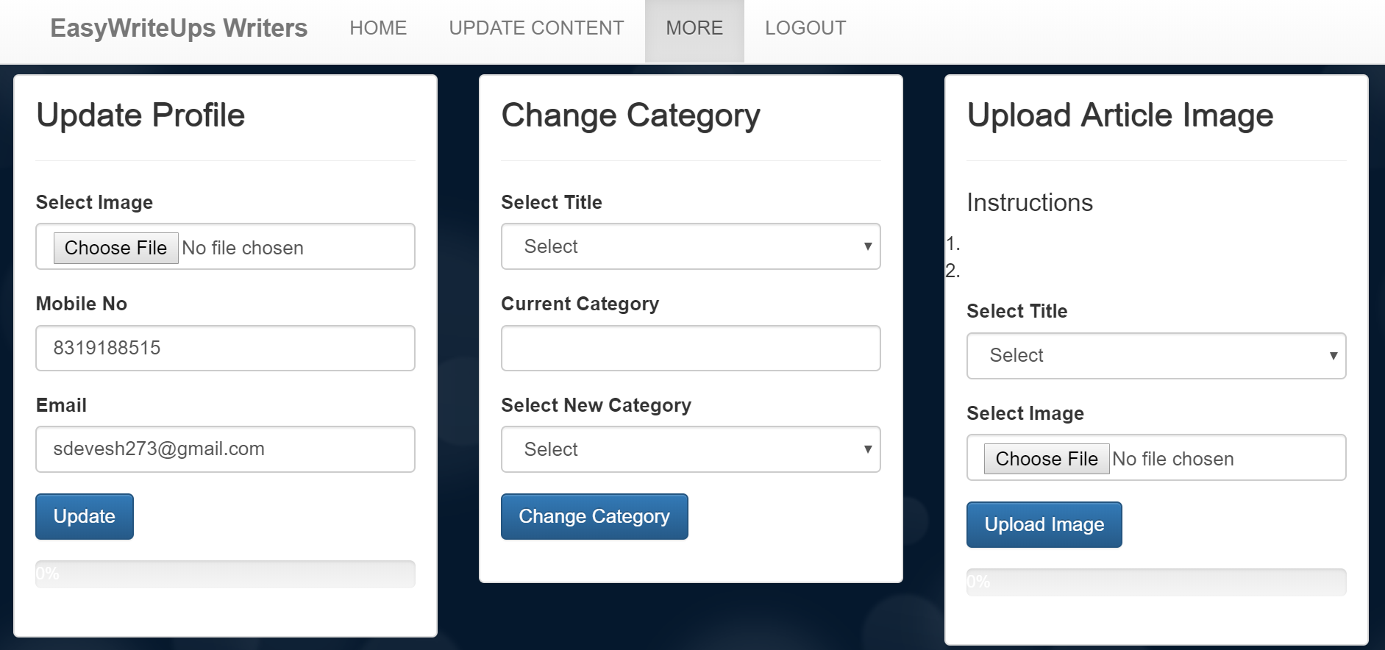
Update Page of Writes Details

Slide 18
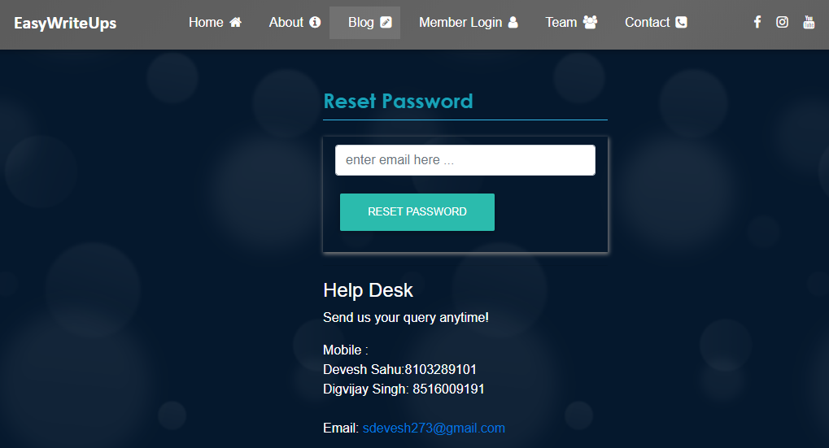
Recover Password

Slide 19
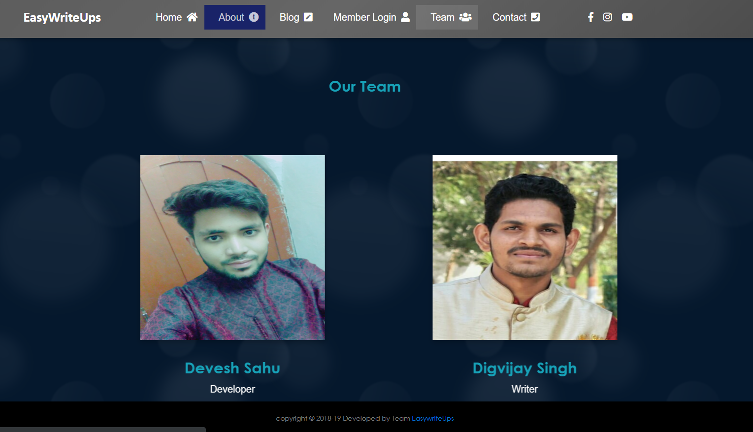
Team Page

Slide 20
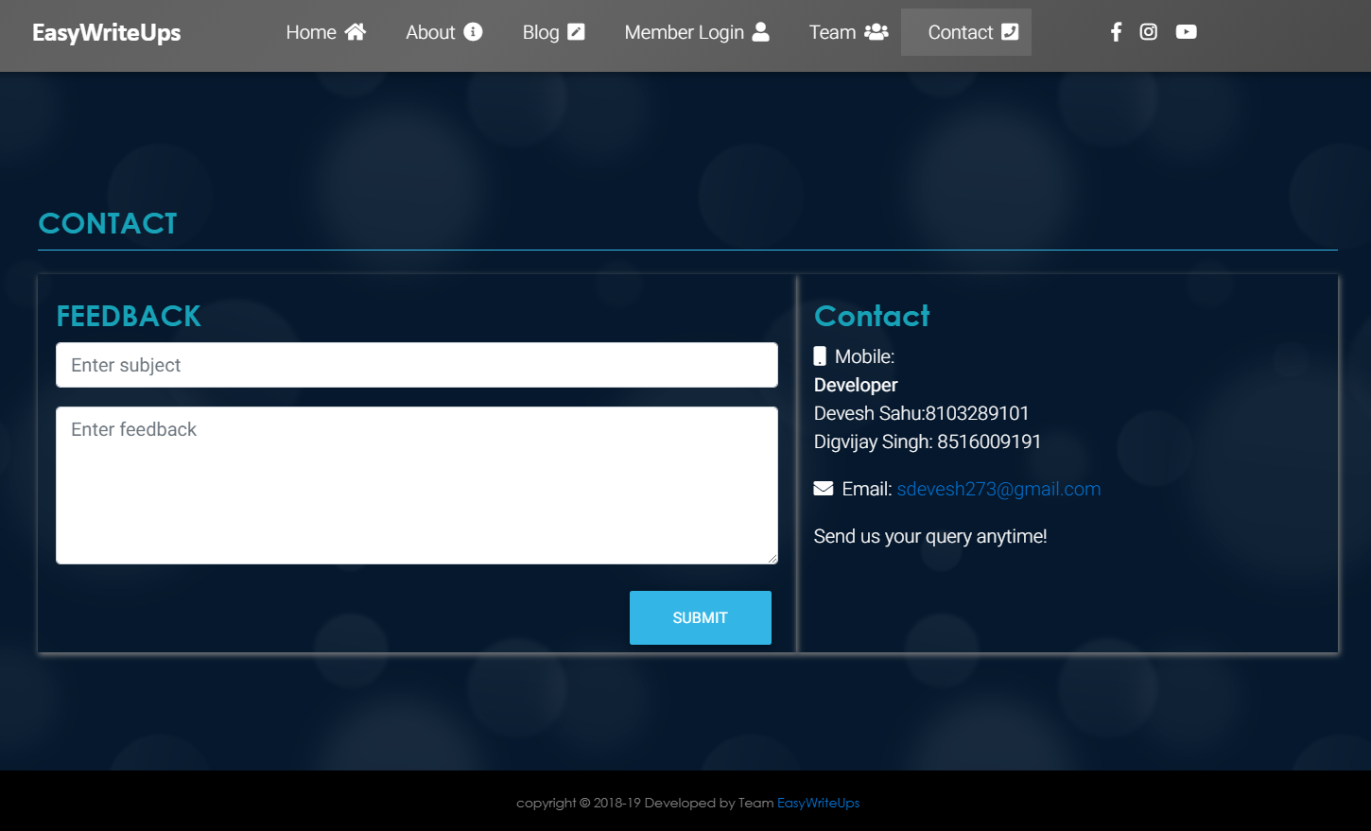
Contact Page

Slide 21
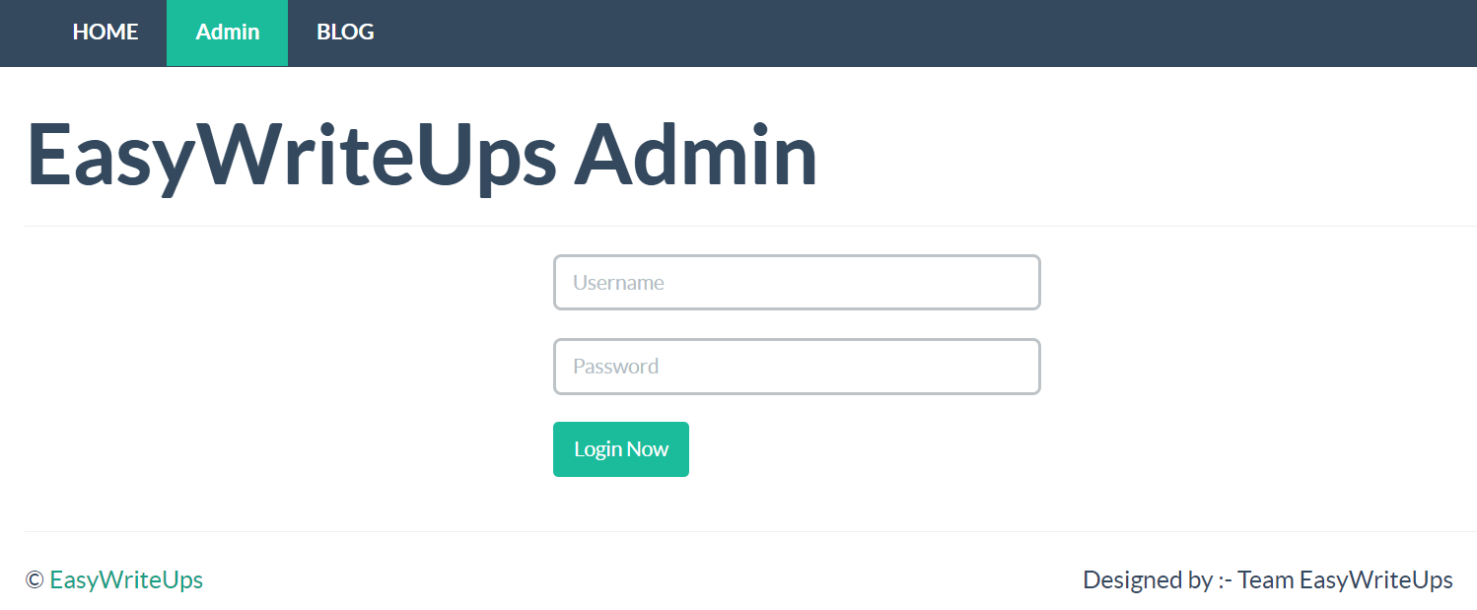
Admin Login

Slide 22
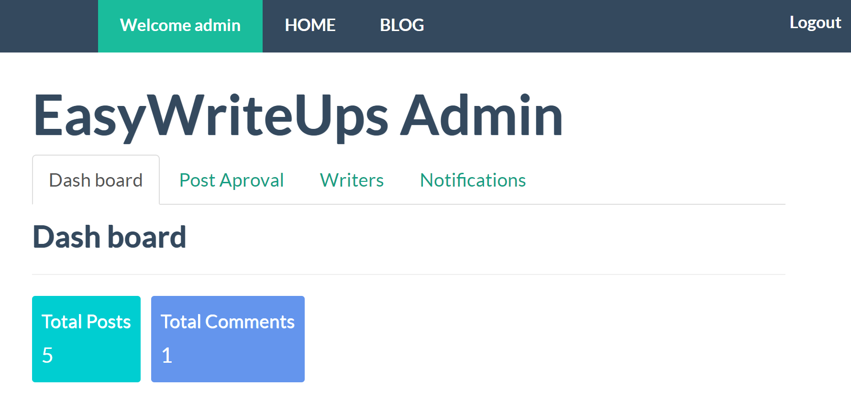
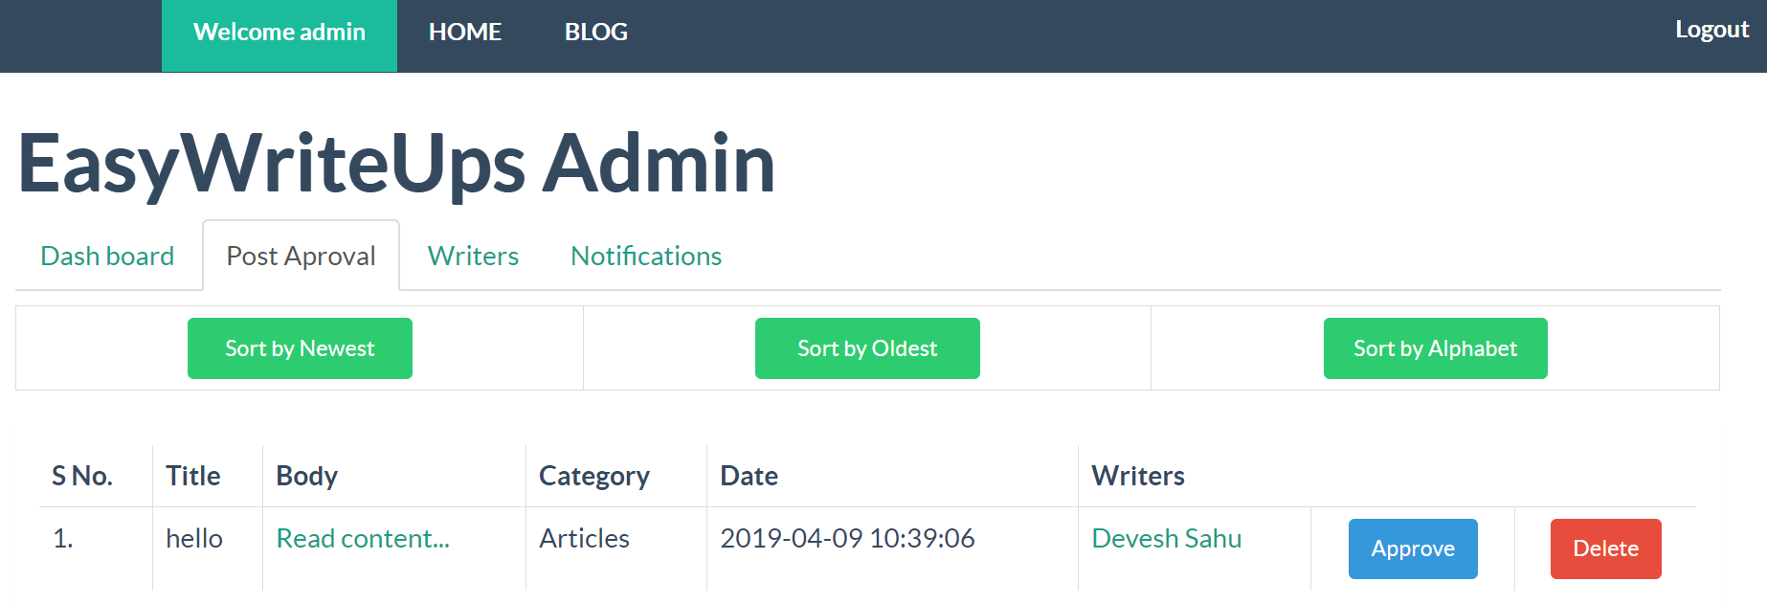
Admin Panel

Slide 23
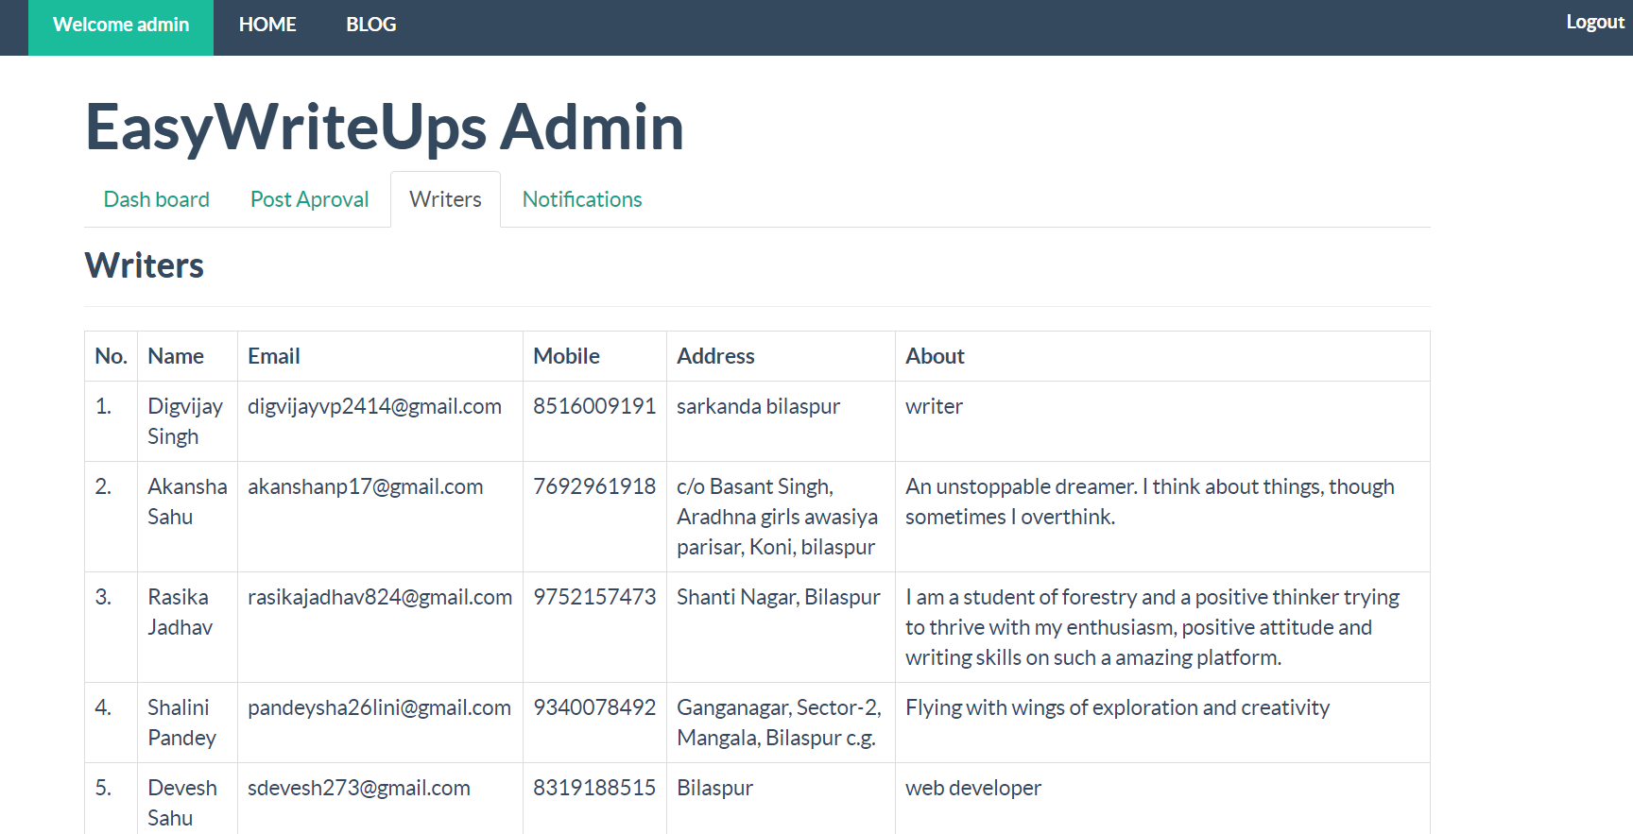
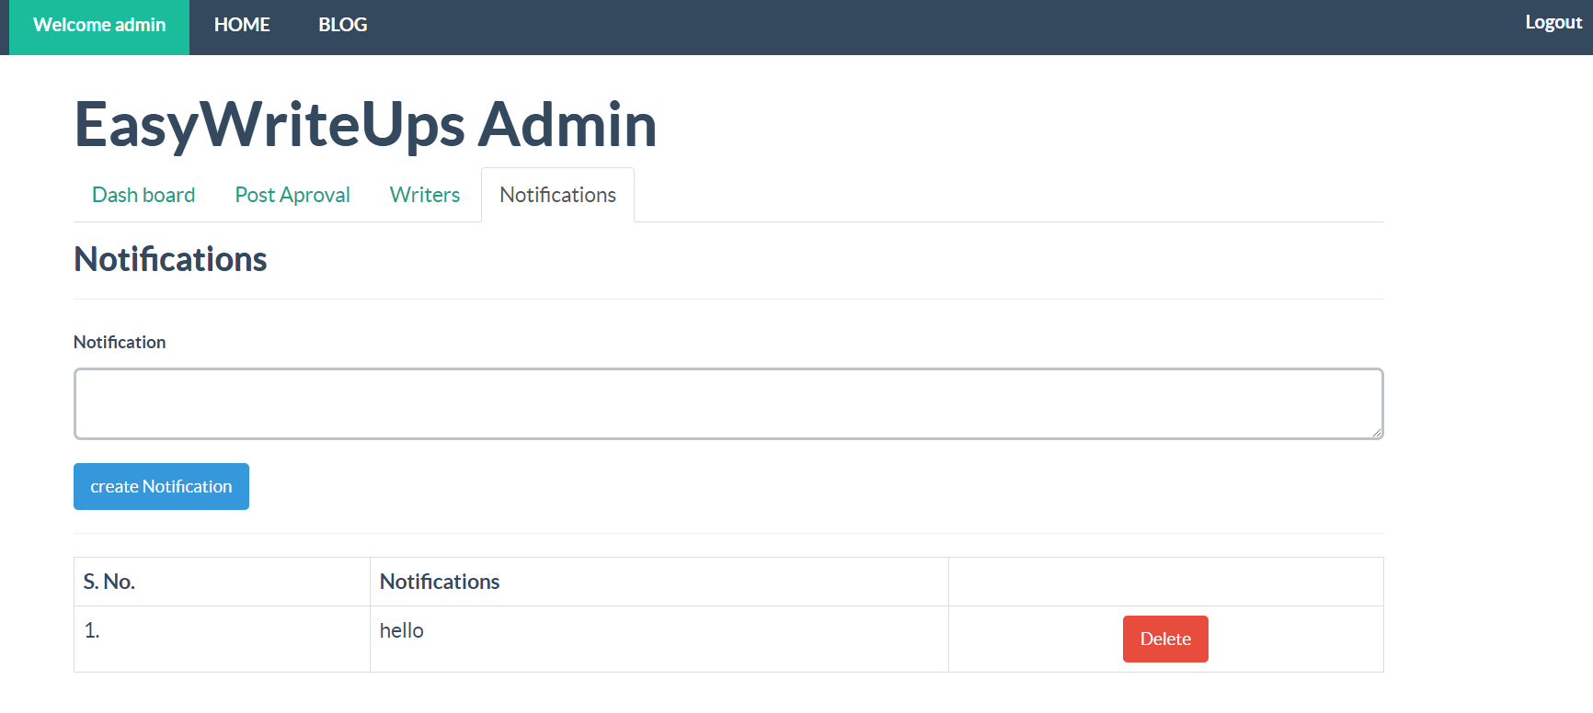

Slide 24
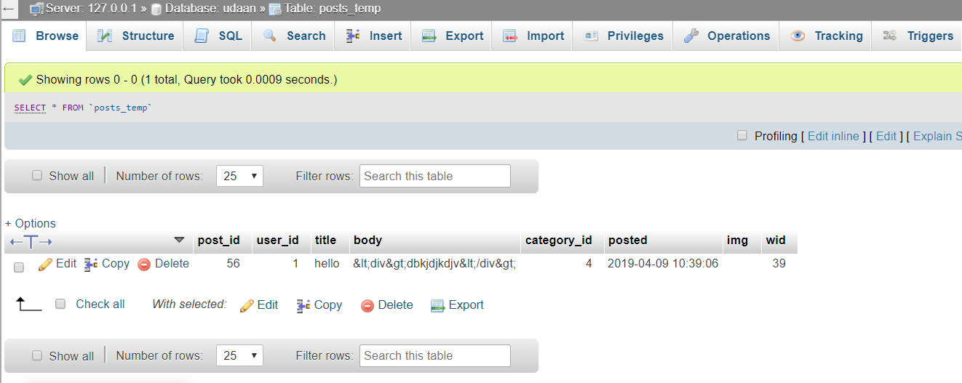
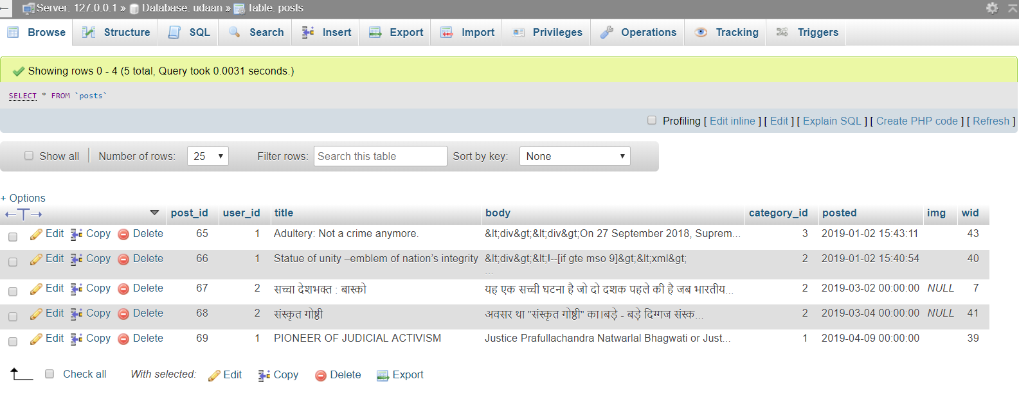
Database
Posts_temp Table:
Post Table

Slide 25
CONCLUSION
This project developed, incorporated all the activities involved in the browsing Centre.
EASYWRITEUPS provides all necessary information to the user with the use EASYWRITEUPS; the user can simply sit in front of the system and monitor all the activities without any physical movement of the file. Management can service the user’s request best in time.
The EASYWRITEUPS provides quickly and valuable information. These modules have been integrated for effective use of the management for future forecasting and for the current need.

Slide 26
FUTURE ASPECTS
Reduces the Usage of Paper and Pages.
Increases the habit to use Websites to Store articles.
To showcase hidden writers of Small towns.
To improve writing skills of writers.
Enhance the security methods.
Normalization of database table to improve database structure & easily retrieval of user data.
To develop auto approval algorithm.

Slide 27
REFERENCE
www.webdeveloper.com
www.w3school.com
www.youtube.com
https://getbootstrap.com
https://fontawesome.com/icons
https://www.php.net/manual/en/intro-whatis.php
https://www.geeksforgeeks.org
https://www.tutorialspoint.com
https://codepen.io/Mr_Smith/pen/YPLoKW

Slide 28
THANK YOU

